Slide 1
Brain Tumor Classification Using Deep Learning
Recorded presentation: https://nileuniversity-my.sharepoint.com/:v:/g/personal/n_mamdouh2198_nu_edu_eg/EdsZd65DzMNNvchbzclf5cgBsWfAjCbZT5CvdFYZY_KtZQ?e=Y3LRmS

Slide 2
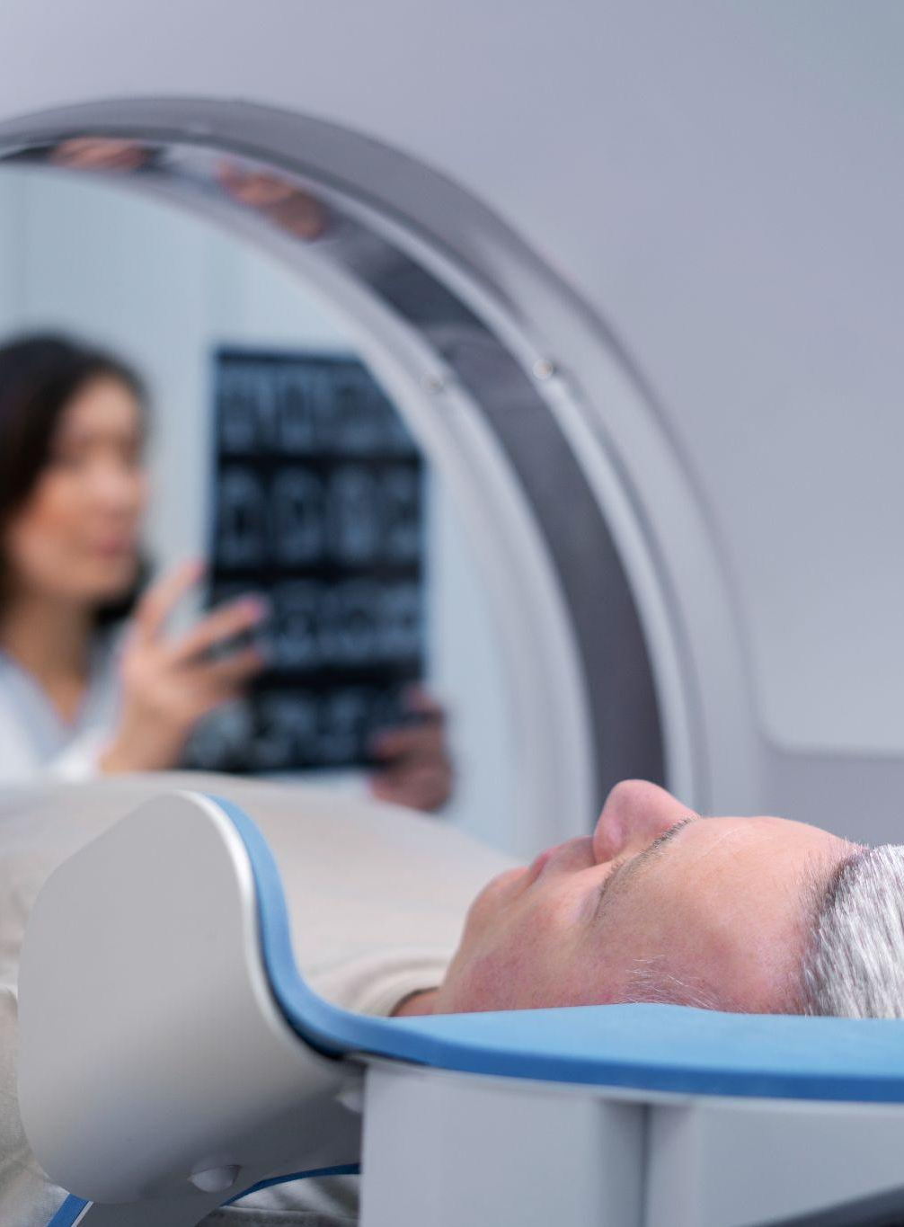
1
Introduction

Slide 3
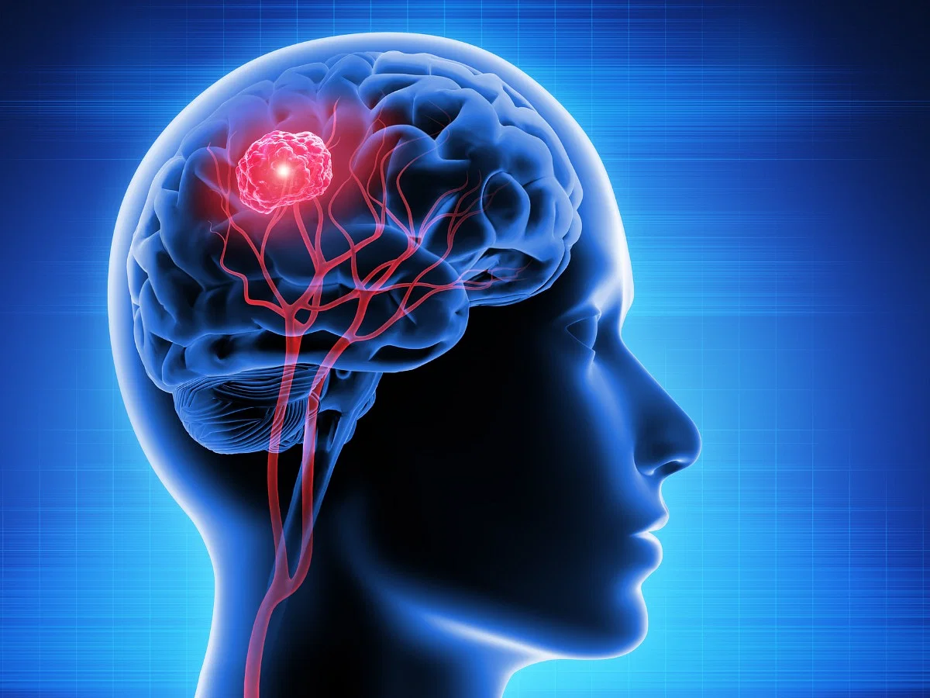
Brain tumors
Changes in personality
Tremors
Seizures
Vomiting
Headaches

Slide 4
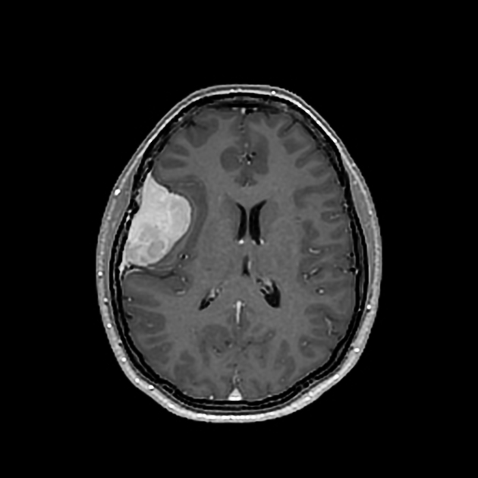
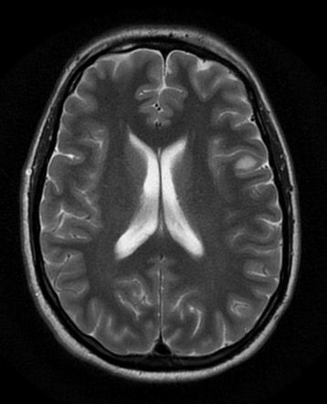
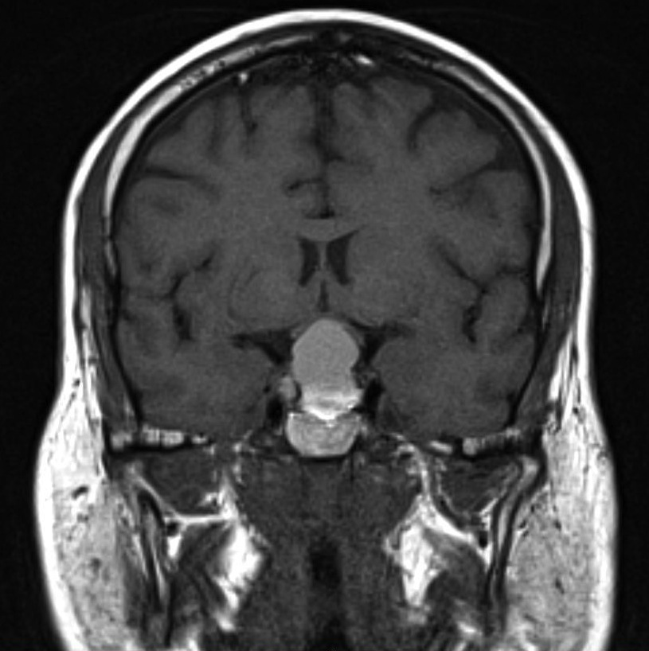
Most common tumor types
Glioma
Meningioma
Pituitary

Slide 5
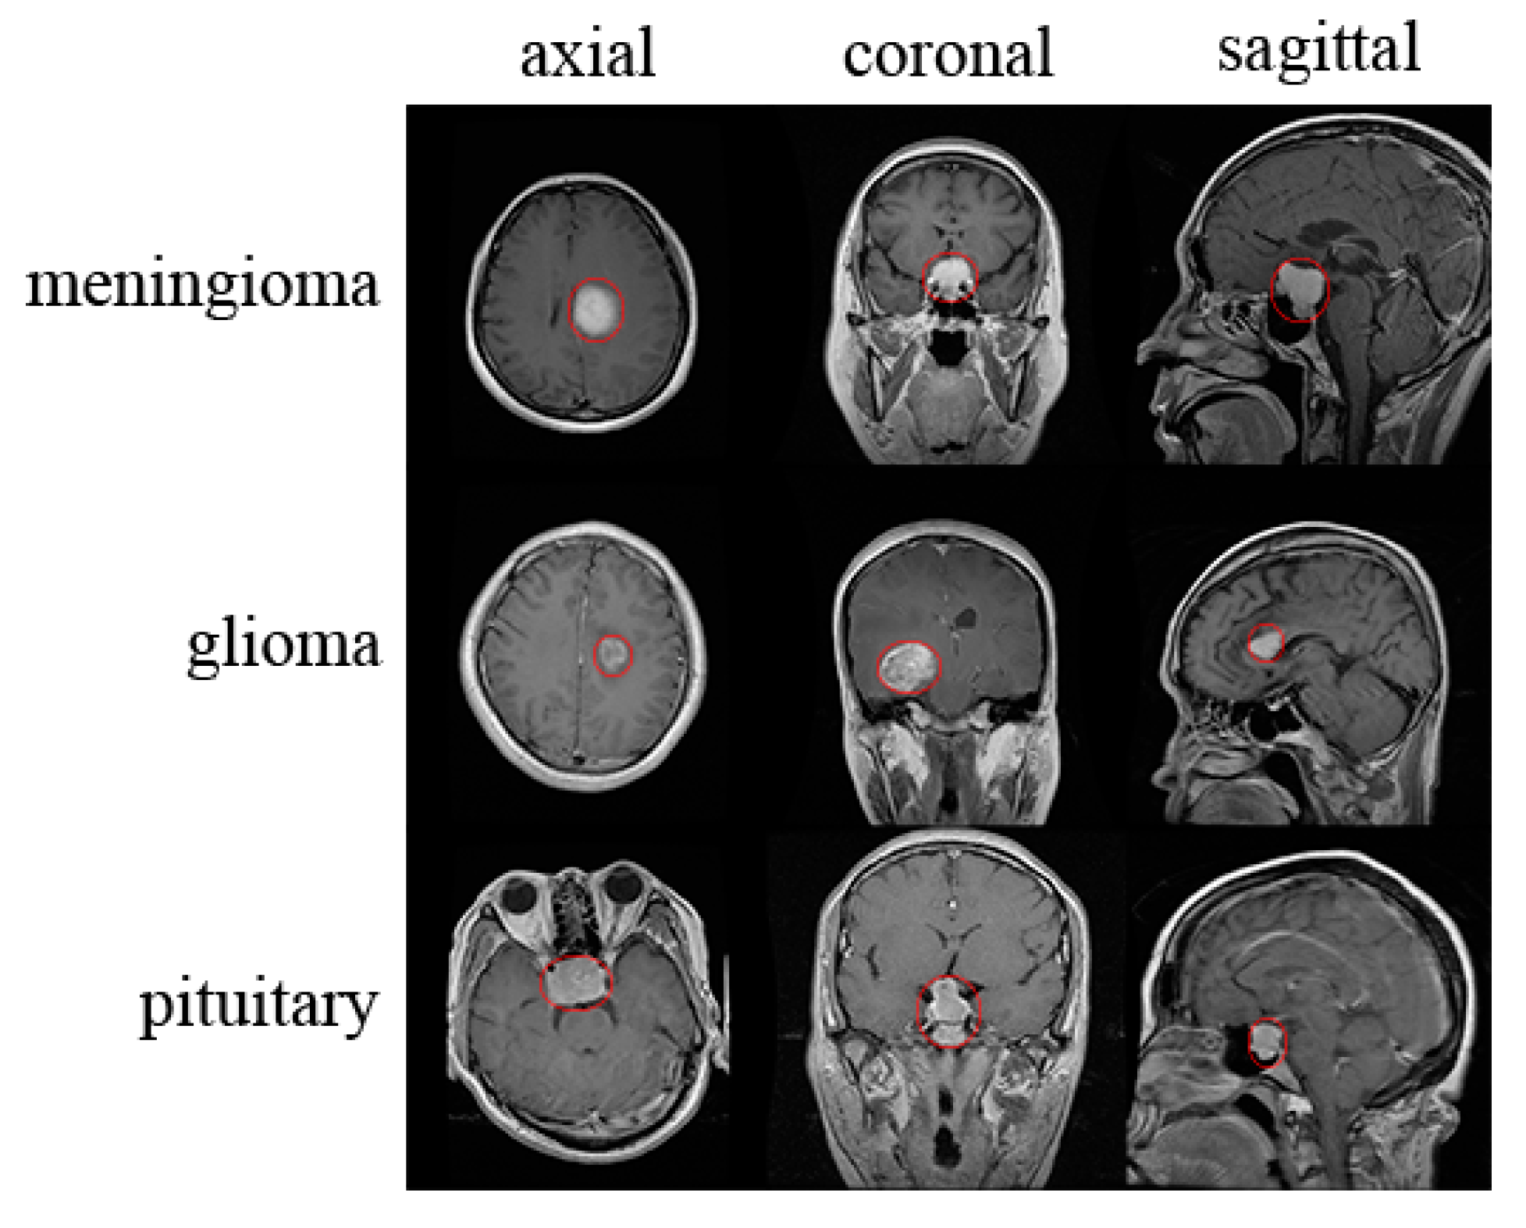
Dataset overview
This dataset consists of testing and training data for the 4 groups: No tumor, pituitary, meningioma, and glioma.
The testing data consists of around 300-400 images for each group separately.
The training data consists of 1300-1600 images for each group separately.

Slide 6
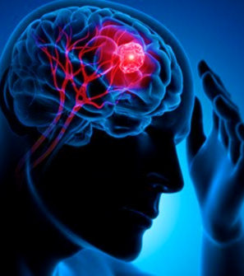
Research question
How accurately can a deep learning model identify and classify different types of tumors using MRI images?

Slide 7
2
Methodology

Slide 8
Importing libraries
CV2
Tensorflow
OS
Matplotlib
1
2
3
4
5
6
7
Numpy
Seaborn
Pandas

Slide 9
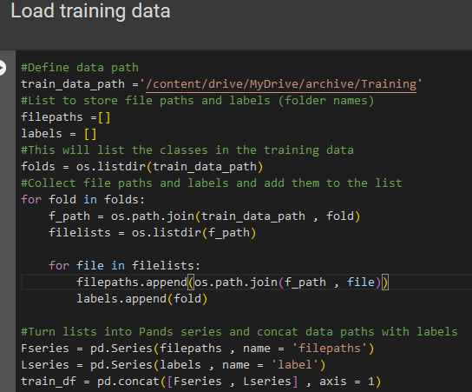
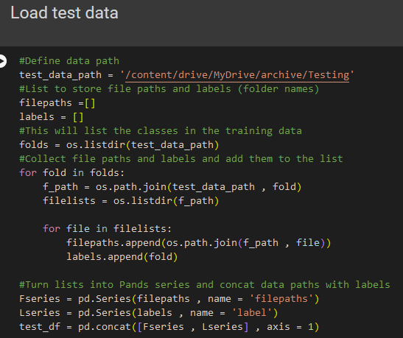
Load train and test data

Slide 10
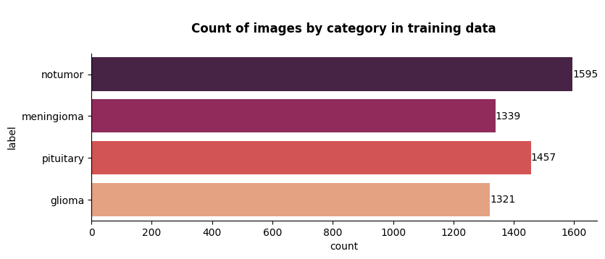
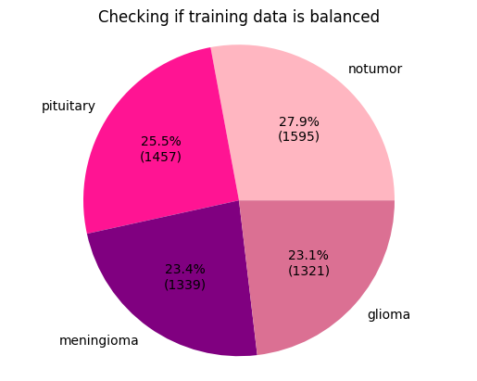
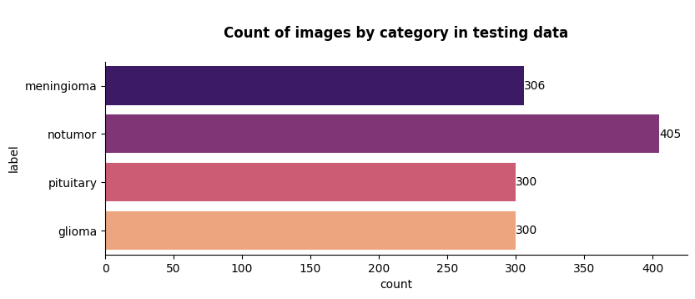
Exploratory data analysis

Slide 11
Splitting the data
Training data
Validation data
Testing data
used to train the actual model while it is still being developed
used to show how the model is learning and adapting
Unseen data that is used to provide an unbiased final evaluation of the model.

Slide 12
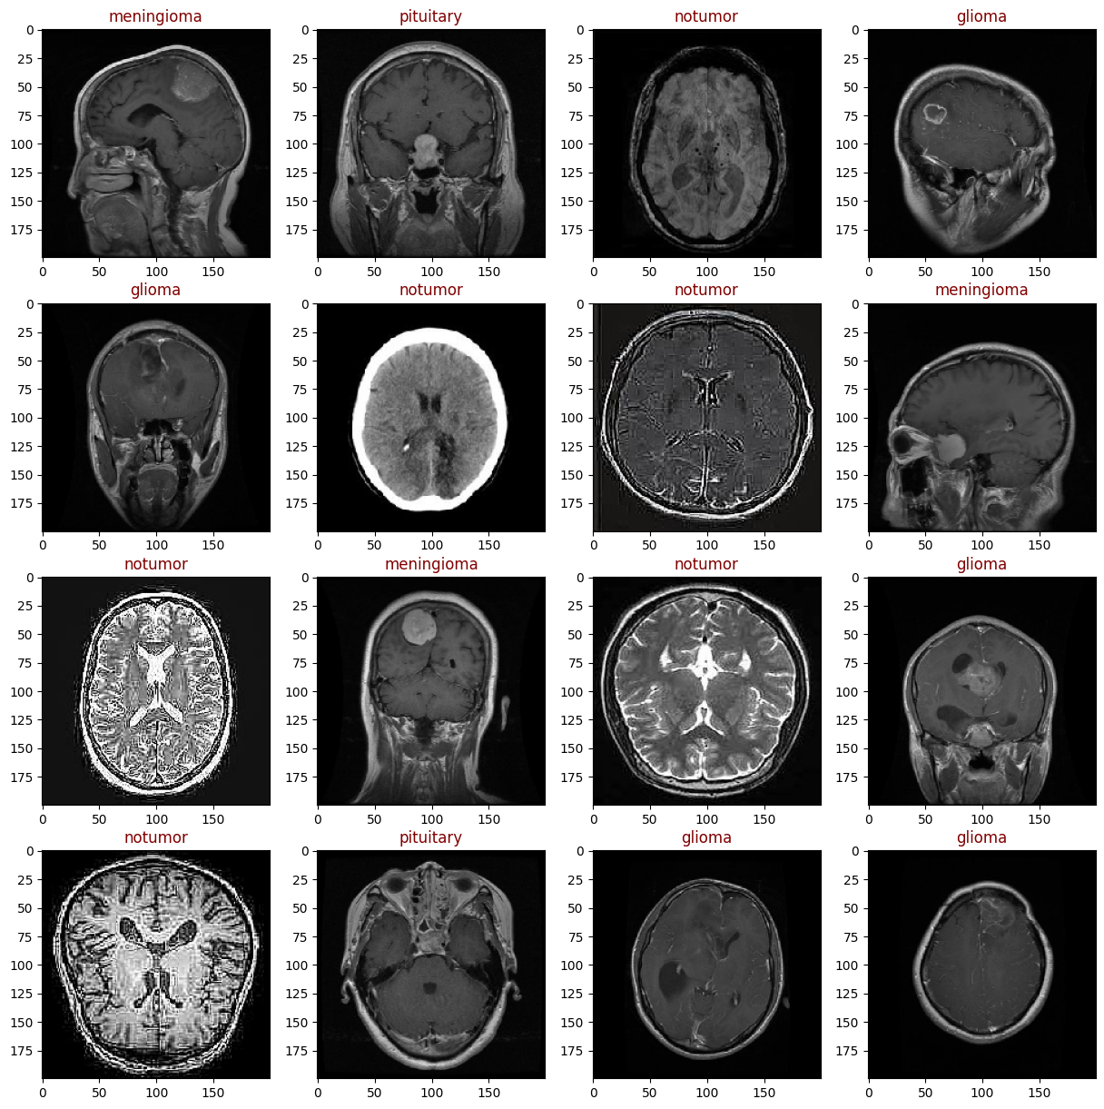
Data resizing
ImageDataGenerator()
200x200 pixels, RGB
Batch size = 36

Slide 13
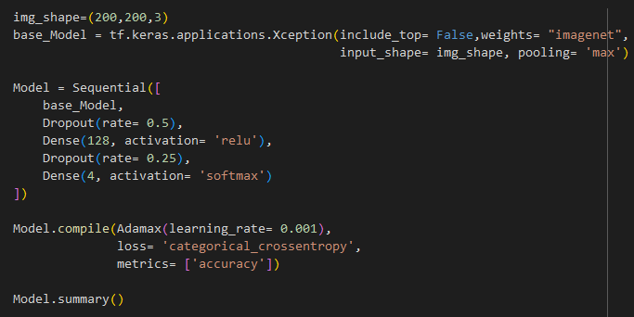
Building the model
Xception base model
Adamax optimizer
Categorical cross-entropy
2 dropout layers
ReLu and Softmax activation
Metric = accuracy

Slide 14
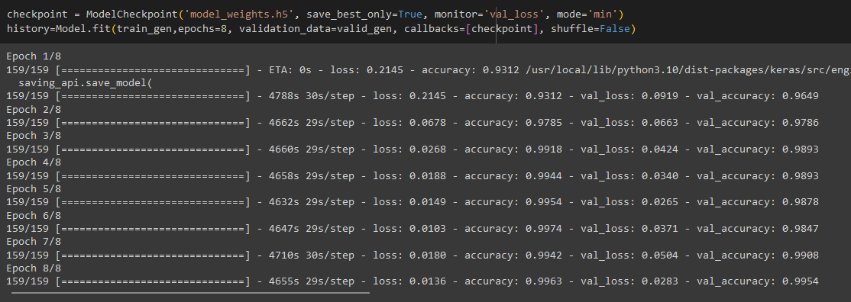
Training the model
Model was trained over 8 epochs

Slide 15
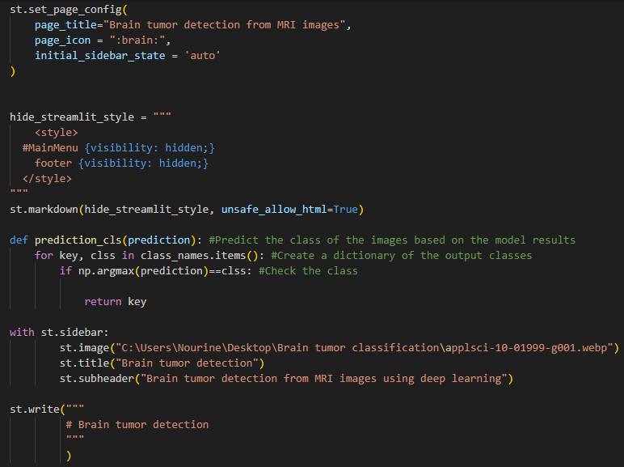
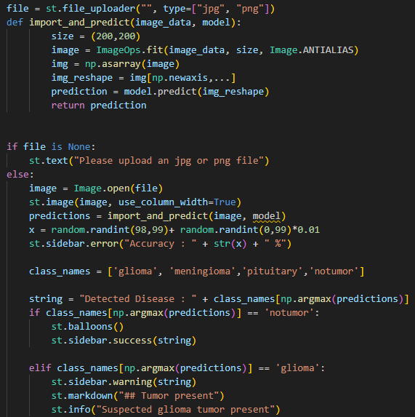
Model deployment using Streamlit
Due to computational limitations, this step could not be finished

Slide 16
3
Results & discussion

Slide 17
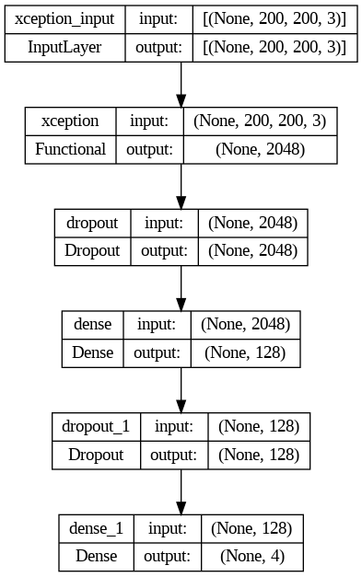
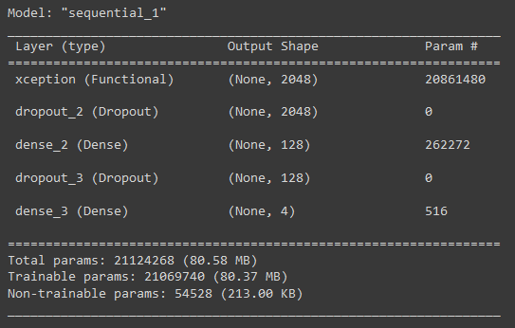
2D CNN model

Slide 18
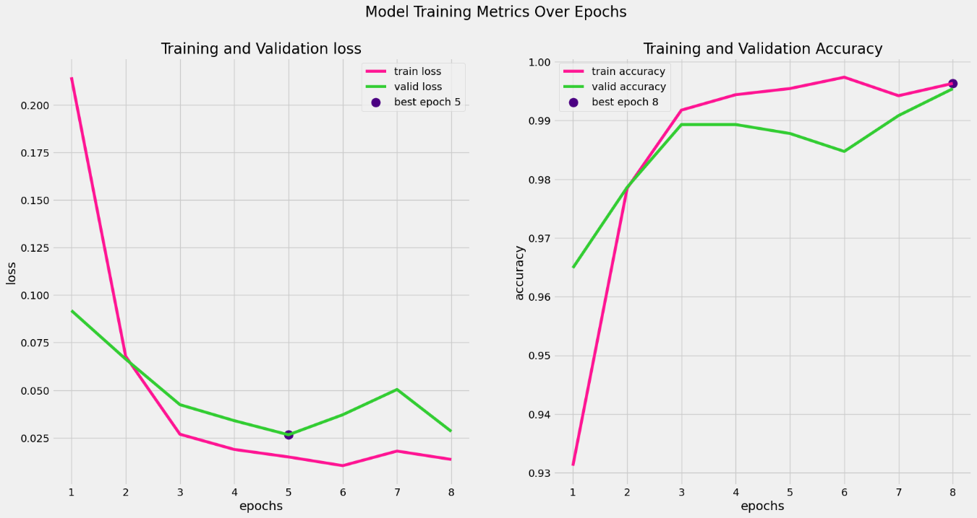
Model training metrics

Slide 19
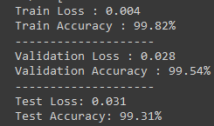
Train, validation, and test accuracy

Slide 20
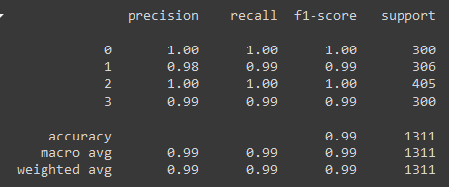
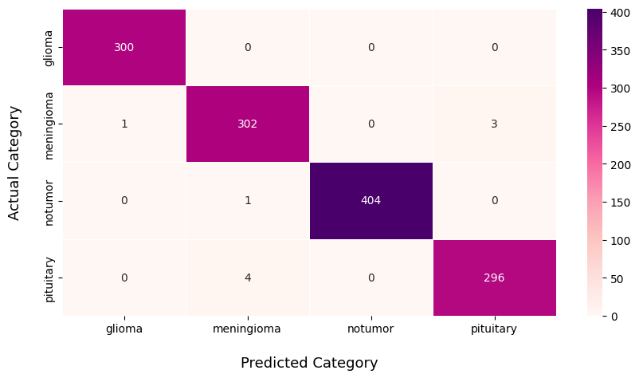
Model evaluation

Slide 21
4
Concluding remarks

Slide 22

Future work: trying different CNN architectures and optimizers.
Limitations: model deployment
Potential for deep learning in healthcare
GitHub repo

Slide 23
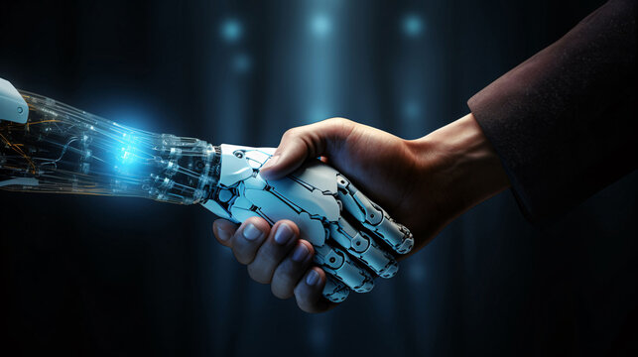

Slide 24

Thanks!
Stay curious ☺

